Slide 1



RETAIL SALES DATA PIPELINE USING AZURE MEDALLION ARCHITECTURE
--Sushil Nandalal Marathe

Slide 2



Contents
1. Introduction
2. Project Aims
3. System Design
4. Folder Structure
5. Implementation
6. Pipeline Overview
7. Key Components
8. CI/CD Pipeline
9. Validation and Monitoring
10. Conclusion

Slide 3
Introduction
In today's data-driven world, organizations generate vast amounts of data daily. To efficiently manage, transform, and derive insights from this data, a robust data pipeline is essential. This project focuses on building an automated Retail Sales Data Pipeline using Azure Data Factory (ADF), Azure Databricks, and Azure Blob Storage, following the Medallion Architecture principles.

Slide 4
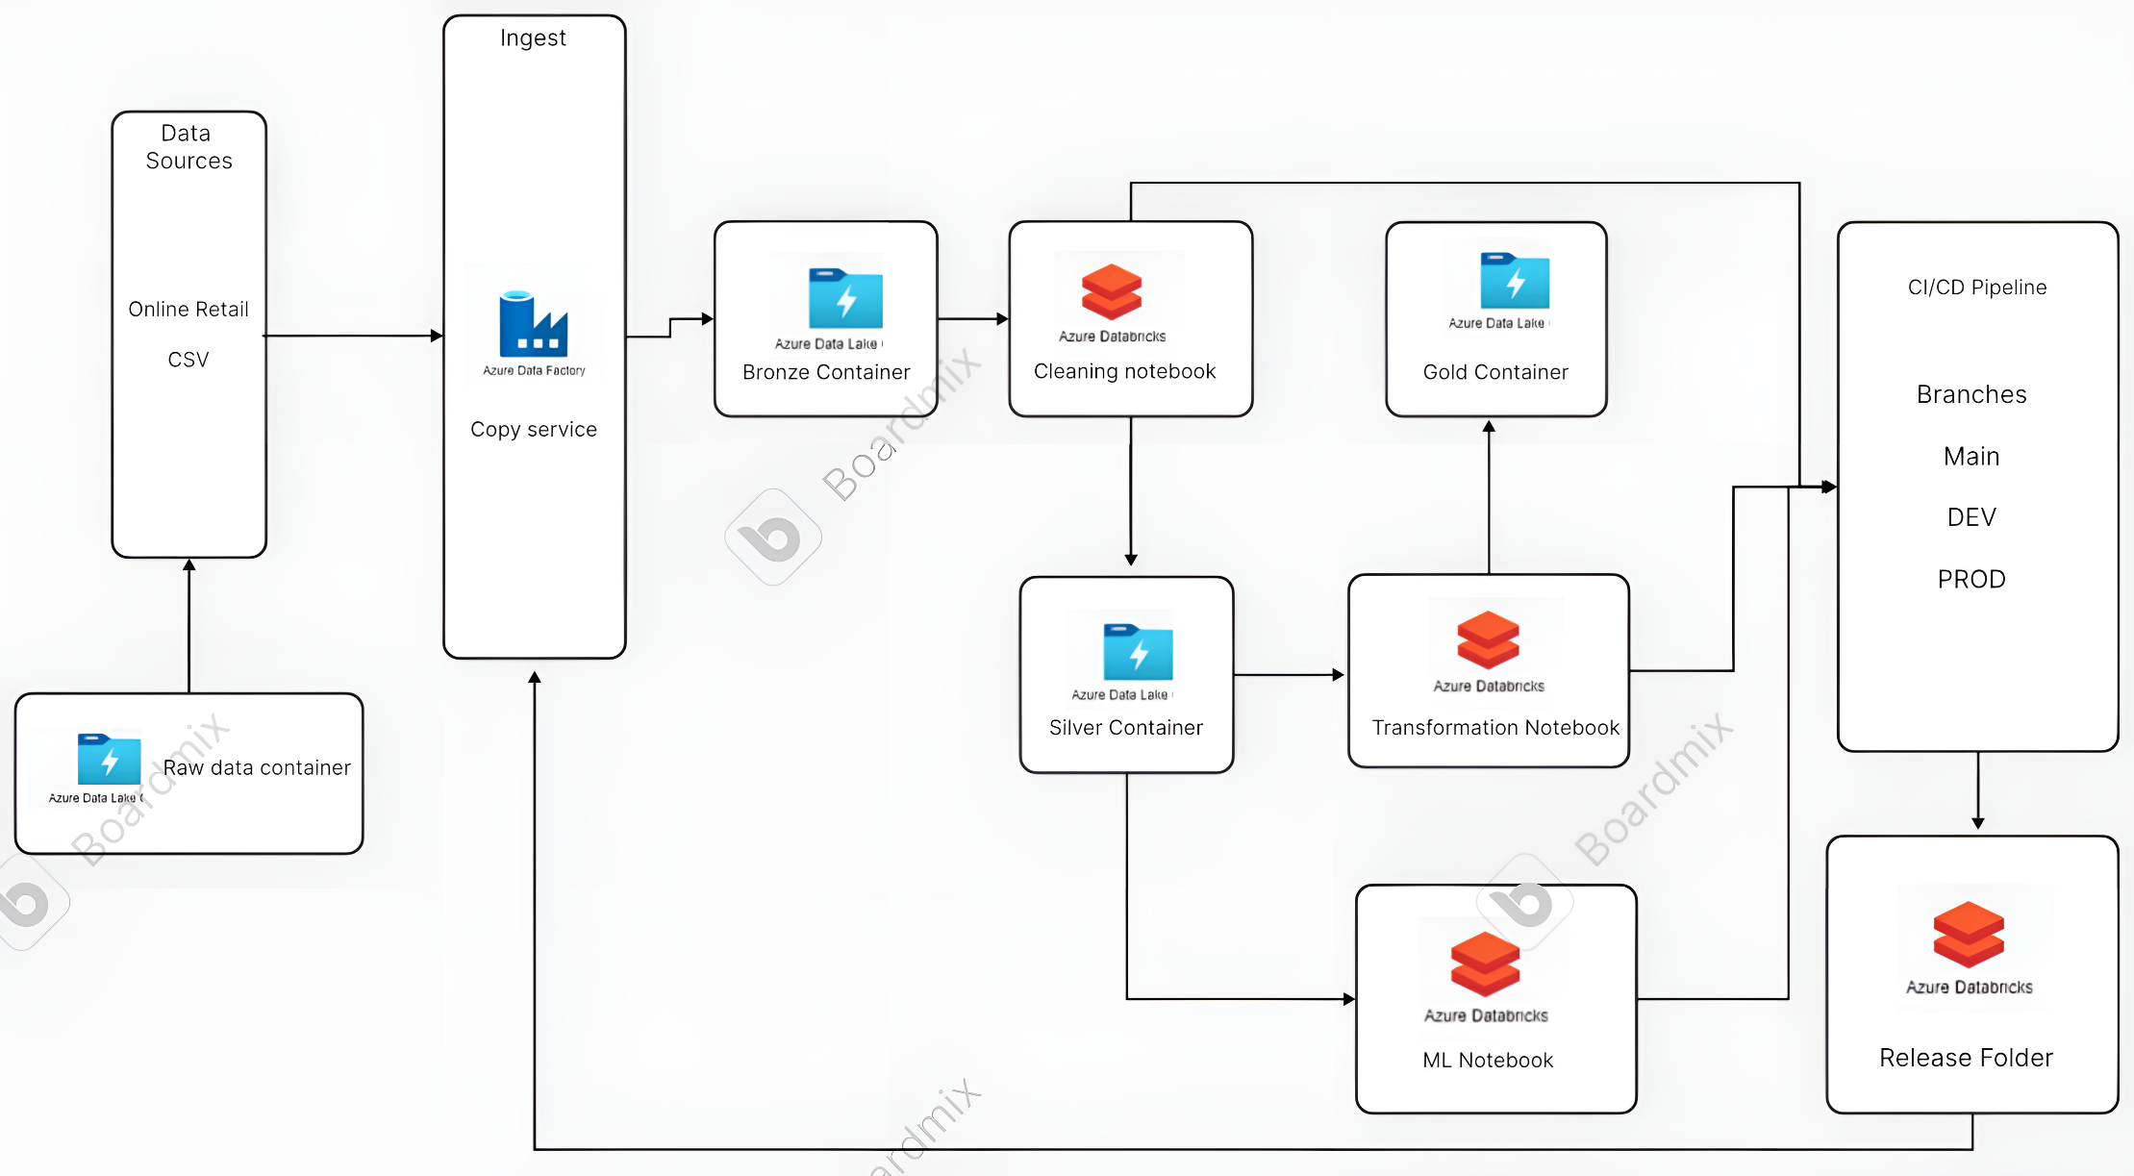
Project Aims
1. Ingest Data
Load raw sales data (CSV) into the Bronze Layer.
2. Transform Data
Process raw data to remove inconsistencies and store it as Parquet files in the Silver Layer.
3. Aggregate Data
Generate region-wise, product-wise, price-wise and date-wise summaries in the Gold Layer.
4. Forecast Sales
Use Linear Regression to predict sales trends for better decision-making.
5. Automation
Design ADF pipelines to automate the data ingestion, transformation, and aggregation workflows.
6. CI/CD Integration
Use Azure DevOps for seamless deployment and version control.

Slide 5

System Design
Data Ingestion
Data Transformation
Copy raw data into the Bronze Layer using Azure Data Factory.
Clean and transform the data in Azure Databricks.
Data Aggregation
CI/CD Integration
Summarize and analyze the data in Databricks Notebooks.
Use Azure DevOps Pipelines for deployment and management.

Slide 6
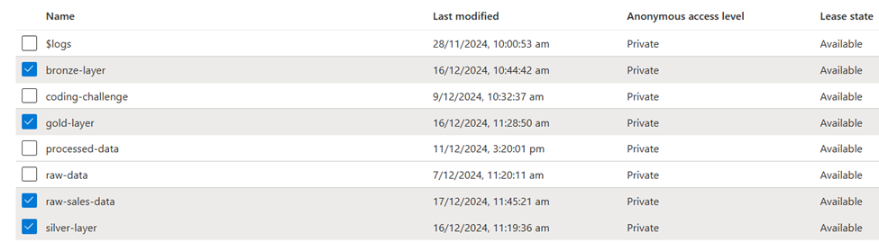
Folder Structure
The following folder structure was used across Azure Blob Storage:
- raw-sales-data (Hot Storage): Contains unprocessed raw data in CSV format.
- bronze-layer: Stores raw data in Parquet format for staging.
- silver-layer: Contains cleaned and transformed data.
- gold-layer: Stores aggregated summaries.
This segregation follows the Medallion Architecture and ensures optimized performance and cost efficiency.

Slide 7
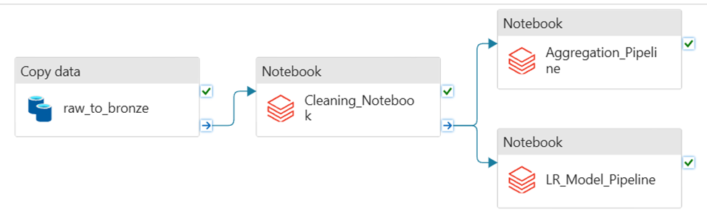
Implementation
The solution was implemented using a pipeline in Azure Data Factory that orchestrated the execution of three Databricks notebooks for data transformation and aggregation. The pipeline also included data ingestion activities.

Slide 8
Pipeline Overview
Ingest Raw Data
Transform and Clean Data
Tool: Azure Data Factory (ADF). Raw sales data (CSV files) from the raw-sales-data container was ingested into the Bronze Layer. Data was stored as Parquet files for optimized performance.
Notebook 1: Retail Sales Data Cleaning. Tool: Azure Databricks (PySpark). Key Steps: Read raw Parquet data from the Bronze Layer, removed null values and duplicate records, standardized date formats, stored the cleaned data in the Silver Layer as Parquet files.
Generate Aggregated Summaries
Apply Machine Learning for Sales Forecasting
Notebook 2: Retail Sales Data Aggregation. Tool: Azure Databricks (PySpark). Key Steps: Created region-wise, product-wise, date-wise, and price summaries. Output data was saved in the Gold Layer.
Notebook 3: Retail Sales Data Model LR. Tool: Azure Databricks. Trained the Linear Regression model using historical sales data.

Slide 9
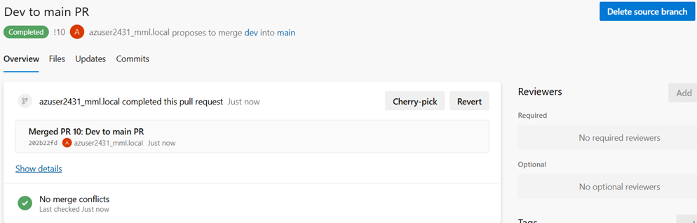

CI/CD Pipeline
Branches
Pipeline
dev: For development and testing. prod: For production-ready changes. Merged into main for release.
Automated deployment of Databricks Notebooks. Release folders created in the Azure Workspace for final outputs.

Slide 10
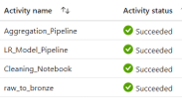

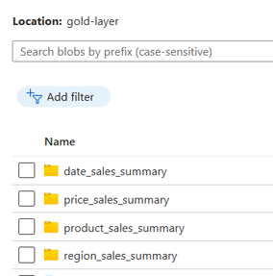
Validation and Monitoring
Pipeline Monitoring
Logs
Output Verification
Monitored pipeline execution in ADF's Monitor section. Activity runs and statuses were reviewed in the Gantt Chart.
Downloaded activity execution logs as CSV files for audit purposes.
Data was verified in the respective storage layers (Bronze, Silver, Gold).

Slide 11
Conclusion
The Retail Sales Data Pipeline was successfully implemented to:
- Automate data ingestion, transformation, and aggregation.
- Generate actionable insights from region-wise and product-wise sales data.
- Forecast sales trends for improved business decisions.
- Implement CI/CD using Azure DevOps for seamless deployment.
This solution demonstrates the scalability and efficiency of Azure services in managing large-scale data workflows following the Medallion Architecture.

